Slide 1
Network Topology
Welcome, students!

Slide 2
Network Topologies
Network topology refers to the shape or the arrangement of the different elements in a computer network (i.e. links and nodes).
Network Topology defines how different nodes in a network are connected to each other and how they communicate is determined by the network's topology.

Slide 3
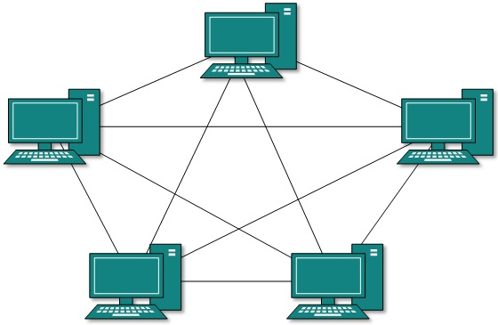
Mesh Topology
Full Mesh
All hosts have a point-to-point connection to every other host in the network. Thus for every new host n(n-1)/2 connections are required.

Slide 4
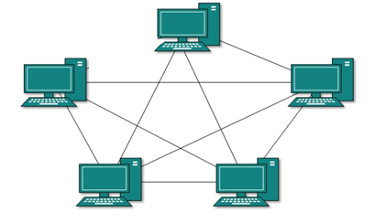
Partial Mesh
Partially Mesh Topology Not all hosts have point-to-point connection to every other host.

Slide 5
Science
Briefly describe the topics you will cover this year in Science.
This may take more than one slide.

Slide 6
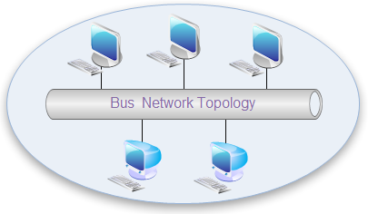
Bus Topology
Bus networks use a common backbone to connect all devices.
All devices are connected to a central cable, called the bus or backbone. Bus networks are relatively inexpensive and easy to install for small networks.

Slide 7
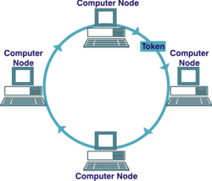
Ring Topology
In Ring Topology, all the nodes are connected to each-other in such a way that they make a closed loop. Each workstation is connected to two other components on either side, and it communicates with these two adjacent neighbors. Data travels around the network, in one direction. Sending and receiving of data takes place by the help of TOKEN.

Slide 8
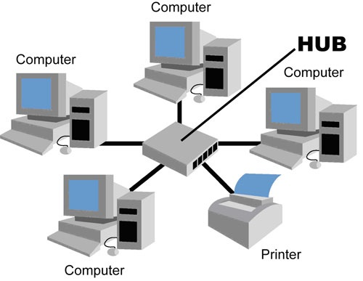
Star Topology
n Star topology, all the components of network are connected to the central device called “hub” which may be a hub, a router or a switch.
All devices are connected to a central hub. Star networks are relatively easy to install and manage, but bottlenecks can occur because all data must pass through the hub

Slide 9
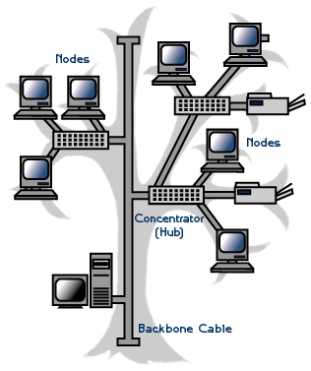
Tree Topology
It is also called Expanded Star Topology.
Tree Topology integrates the characteristics of Star and Bus Topology.
In Tree Topology, the number of Star networks are connected using Bus.
This main cable seems like a main stem of a tree, and other star networks as the branches.

Slide 10
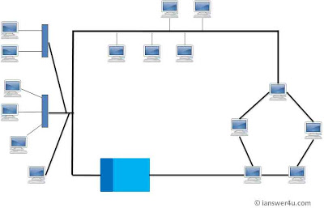
Hybrid Topology
This type of topology we integrate two or more different topologies to form a resultant topology which has good points(as well as weaknesses) of all the constituent basic topologies rather than having characteristics of one specific topology.

Slide 11
Thank You !!!

